Slide 1



HOSPITAL MANAGEMENT SYSTEM
DSA PROJECT

Slide 2
Presented by:
ASIFA SIRAJ (CT-22070)
FILZA TANVEER (CT-22057)
SUMMAIYA FARHAT (CT-22054)
SECTION: B

Slide 3

PURPOSE OF THE PROJECT
The goal of the hospital management system project is:
To efficiently organize patient and doctor data within the hospital.
To save, modify, and retrieve patient and doctor data as needed.
Enable smooth administration of tasks associated with a hospital.
Data Structure Used: Single Linked List

Slide 4

INTRODUCTION OF OUR PROJECT:
Our Project “Hospital management system” focuses on:
Administration of Patient’s data and Administration of Doctor’s data.
The system offers features for adding, editing, searching, and deleting patient records and doctor records to facilitate various hospital operations.
It also facilates doctor to access their patients list and to search for specific patient using IDs. assigned to them.
It has Password-protected access and input validation
The patient and doctor's records are only accessible to admin.

Slide 5
DATA STRUCTURE USED : SINGLY LINKED LIST
The singly linked list is used over here to maintain:
An efficient structure for storing and managing patient and doctor records in a hospital setting.
Each node represents a patient, and the linked list allows for easy traversal, insertion, searching, and deletion of records.
Similarly, each node represents a doctor and the linked list allows for easy traversal, insertion, searching, and deletion of records.

Slide 6
TAIL
HEAD
DATA OF DOCTOR 1
DATA OF DOCTOR 2
DATA OF DOCTOR 3
Each Node of Link List Represents the Data of Doctor

Slide 7
Slide Title
CLASS USED:
ADMIN CLASS FOR PATIENTS
We have made a class in the code defined as “admin”, for easy administration of patients it can perform the following function:
Enables admin to add patient data and edit patient data.
Moreover, it allows the admin to search data of the specific patient and to remove records of the patient using the patient’s ID.
The class includes functions to check and validate user inputs such as names, IDs, etc.
It also implements a simple password protection mechanism for an administrator login.

Slide 8
FUNCTIONS USED IN ADMIN CLASS
FIRST UP CONSULTANTS
add_data
It prompts the user to add details of patients, data of each patient is stored in a single node(temp).
Then it connects that node with the link list.
Edit_Record
It is responsible for modifying patient’s record in a linked list
Prompts user to input patient ID which they want to edit
The patient information in a found node is updated with the edited details from the temporary node.

Slide 9
FIRST UP CONSULTANTS
HEAD
TAIL
DATA OF PATIENT 1
DATA OF PATIENT 2
DATA OF PATIENT 3
temp
ADDED NODE
ADDING RECORD OF PATIENT

Slide 10
search_Record
It allows users to search for patient’s records in a linked list using a patient ID.
The user is prompted to enter the patient’s ID they want to search for.
The linked list is traversed to find patients with specified IDs.
Delete_record
It allows users to remove a patient’s record from a linked list using a patient ID.
The user is prompted to enter the patient’s ID they want to delete.
The linked list is traversed to find the patient ID that which user wants to delete.

Slide 11
REMOVE
TAIL
HEAD
DATA OF PATIENT 1
DATA OF PATIENT 2
DATA OF PATIENT 3
Prev
Curr
Curr
Next
DELETING THE RECORD OF PATIENT

Slide 12
Slide Title
CLASS USED:
ADMIN CLASS FOR DOCTORS
The class defined as “admin2” is created, for easy administration of doctors it can perform the following function:
Enables admin to add doctor data and edit doctor data.
Moreover, it allows the admin to search data of the specific doctor and to remove records of the doctor using the doctor’s ID.
The class includes functions to check and validate user inputs such as names, IDs, etc.
It also implements a simple password protection mechanism for an administrator login.

Slide 13
FIRST UP CONSULTANTS
HEAD
TAIL
DATA OF DOCTOR 1
DATA OF DOCTOR 2
DATA OF DOCTOR 3
temp
ADDED NODE
ADDING RECORD OF DOCTOR

Slide 14
Slide Title
PATIENT CLASS
The class defined as “patient”, is inherited from the administration class of patient:
It is designed to facilitate patient interaction within the hospital management system.
It allows patients to log in and search for their medical records stored in a linked list managed by the admin class.
The class includes functions to check and validate user inputs.

Slide 15
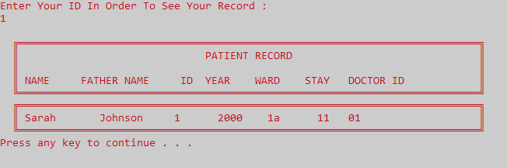
Slide Title
Patient can search their record using their ID

Slide 16
Slide Title
DOCTOR CLASS
The class defined as “doctor”, is inherited from the administration class of doctor:
Allows doctors to log in and verify their identity against doctor records stored in a linked list managed by admin2 class.
Enable doctors to view their records.
Enable doctors to search for specific patients using their IDs.
Provides functionality to view the list of all patients.
The class includes functions to check and validate user inputs.

Slide 17
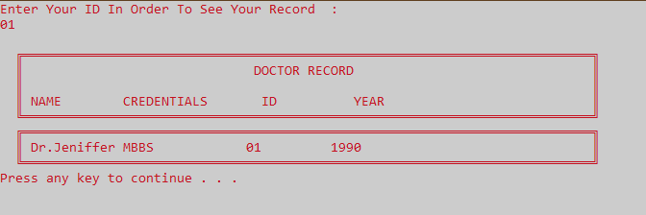
Slide Title
Doctor can search their record using their ID

Slide 18
Slide Title
CONCLUSION:
Using this management system we can:
Easily access and retrieve patient and doctor details by allowing various operations on their records.
It shows accurate maintenance of patient and doctor details.
The system aims to streamline administrative tasks and improve the efficiency of hospital management.

Slide 19
Slide Title
THANK YOU

